Slide 1
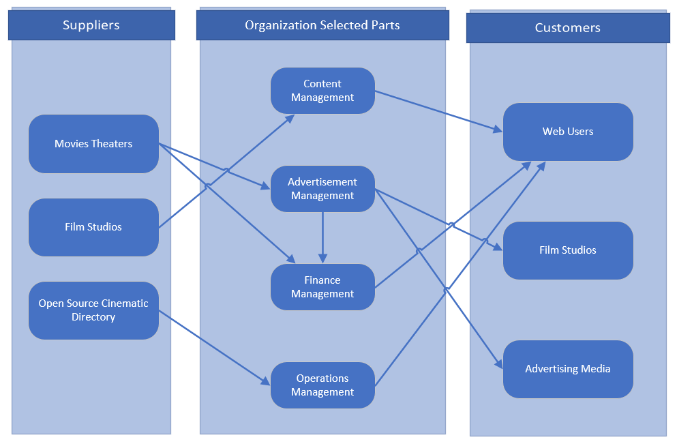
Movie Library Database Business Relationship Map

Slide 2
User Roles by Business Group
External Users
Web Users
Film Studios
Advertising Media
Internal Users
Business Group | User Roles | Team Member Name (Bus. Group Proxy)
Content Management | Partner Relationship Manager(responsible for content creation and external users relationship) | Michael Lee
Advertisement Sales Management | Advertisement Sales Representative | Swapnil Lonkar
Finance Management | Accountant | Suraj Kolari
Operations Management | Business Manager | Rodrigo Martins

